Slide 1
PID policies
DEIC Strategic Webinar on Persistent Identifiers (PIDs)
Kirsten Krogh Kruuse, Royal Danish Library

Slide 2

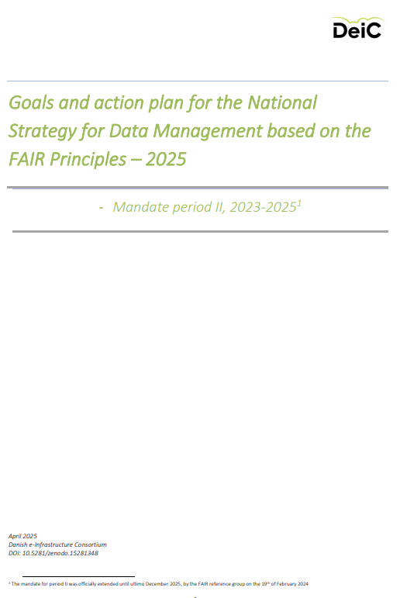
Policy documents
2021
National strategy for data management based on the FAIR principles (Link)
2025
Goals and action plan for the National Strategy ... (Link)
Working Group A: Policies, tools, and research support for FAIR data management
Members from 6 universities, DEIC, and Royal Danish Library.

Slide 3
Working Group A: Policies, tools, and research support for FAIR data management
Focus area 2
What policies and motivating/supportive measures exist to support access to and reuse of research data, including the use of Persistent Identifiers (PIDs) for digital research objects (data, software, instruments, publications, etc.)?
Goal(s):
Collect and summarise policies and examples of motivating and supporting efforts to access and reuse research data, at universities and selected research institutions.
Identify challenges and make recommendations.

Slide 4
What have we learnt?
All Danish universities have a policy or rules for handling research data, and most of them relate to the Danish Code of Conduct for Research Integrity from 2014 and the FAIR principles from 2016.
Persistent identifiers are only mentioned specifically in a few data management policies, but they are part of the services offered by many repositories.
Recommendation
The universities should explicitly formulate and adopt local data management and PID policies, relating to use of national and international infrastructure.

Slide 5
Focus area 3
Describe best practices for data governance and policies/guidelines for overseeing overall data responsibility, even after researchers have left the institution and/or project funding has ceased.
Goal(s):
Identify and recommend best practices for data governance and policies to manage the overall responsibility for data.
How can we foster a culture where data sharing and open science are the expected standards?

Slide 6
Workplan for 2025 – focus area 3
Policy
Userinterface/experience
Infrastructure
Incentives
Communities
How can we foster a culture where data sharing and open science are the expected standards?
Find examples of initiatives that strengthen data governance.
What needs do researchers have regarding research IT support?
The usage of and demand for DMPs.
Will new policies be introduced with the launch of DeiC Dataverse or other infrastructure?
Clarify how PIDs can be used to support access to and reuse of research data.
Make it required
Make it rewarding
Make it normative
Make it easy
Make it possible
Nosek, B. (2019). Strategy for culture change. Center for Open Science. https://www.cos.io/blog/strategy-for-culture-change

